Slide 1

COVID-19 SPREAD ANALYSIS

Slide 2

The coronavirus (COVID-19) pandemic has had a significant impact on public health and has created an urgent need for data-driven insights to understand the spread of the virus. By analyzing the coronavirus dataset, we aim to gain valuable insights into the spread and impact of the virus, providing valuable information for public health responses and decision-making.
COVID-19 | 2020

Slide 3
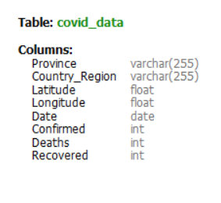
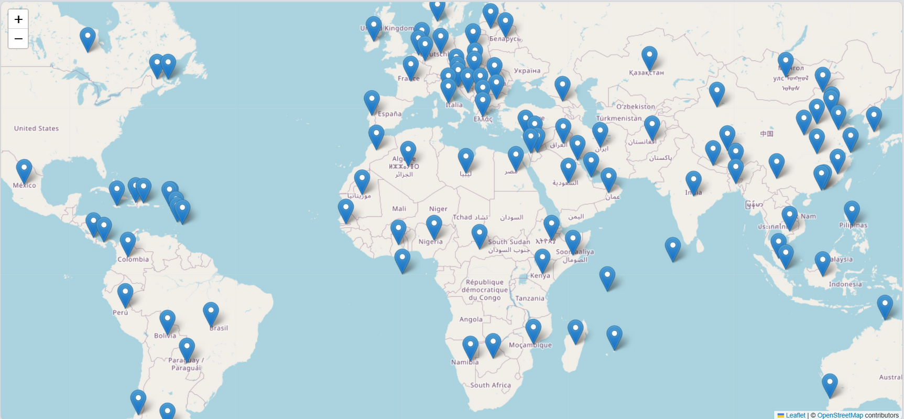

DATA OVERVIEW
78,386
Number of records:
entries
121
countries
COVID-19 | 2020

Slide 4
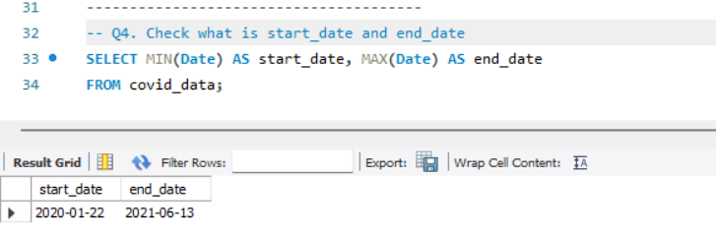

DATA OVERVIEW
Start Date of Collecting Corona Data:
2020-01-22
End Date of Collecting Corona Data:
2021-06-13
18
Months
COVID-19 | 2020

Slide 5


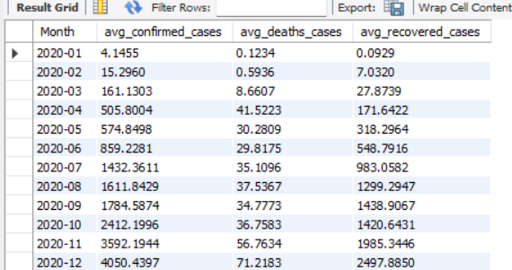
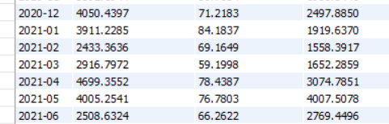
TEMPORAL ANALYSIS
2020
Monthly average recoded cases
2021
Monthly average recoded cases

Slide 6
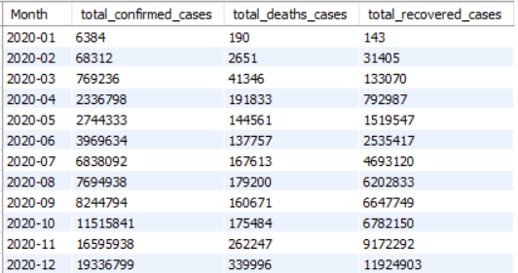
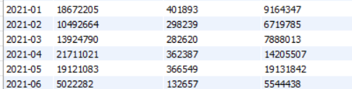
TEMPORAL ANALYSIS
2020
Monthly total recoded cases
2021
Monthly total recoded cases

Slide 7
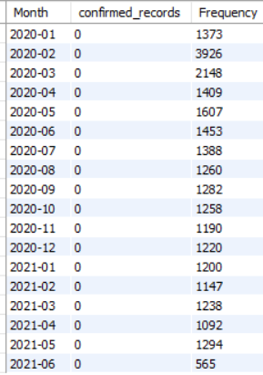
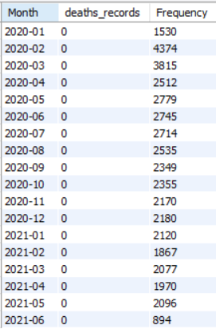
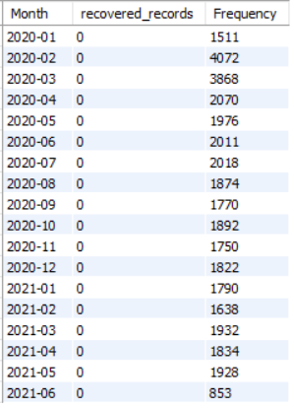
TEMPORAL ANALYSIS
Despite these monthly averages and totals observed, The mode “most frequent” value for the number of recorded cases in confirmed, deaths, and recovered cases per month was always ZERO
Deaths
Recovered
Confirmed

Slide 8
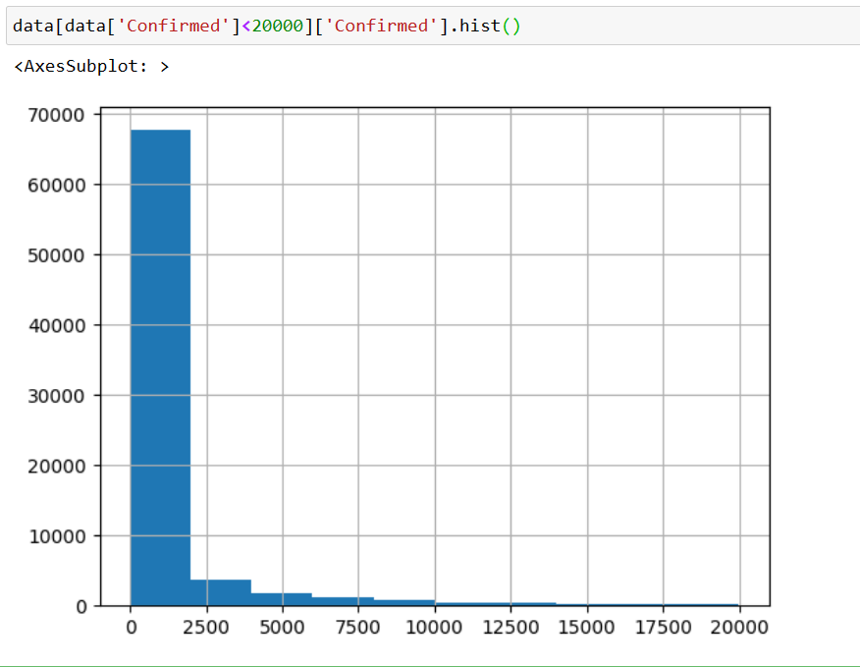
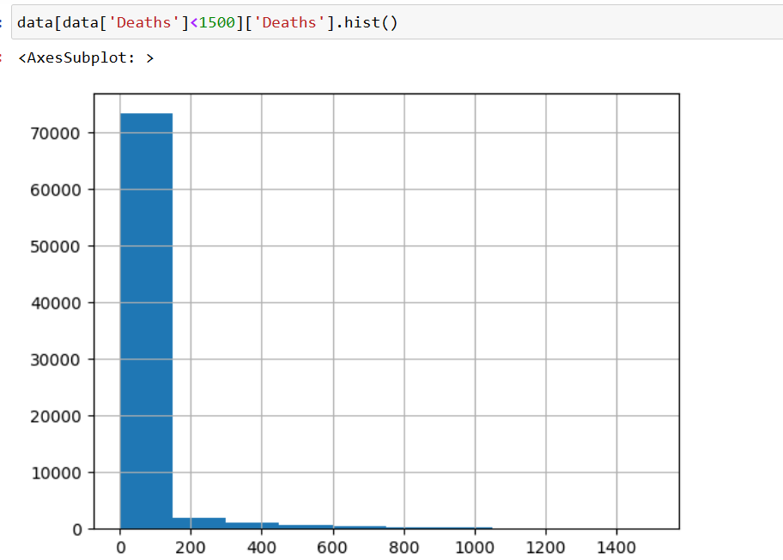
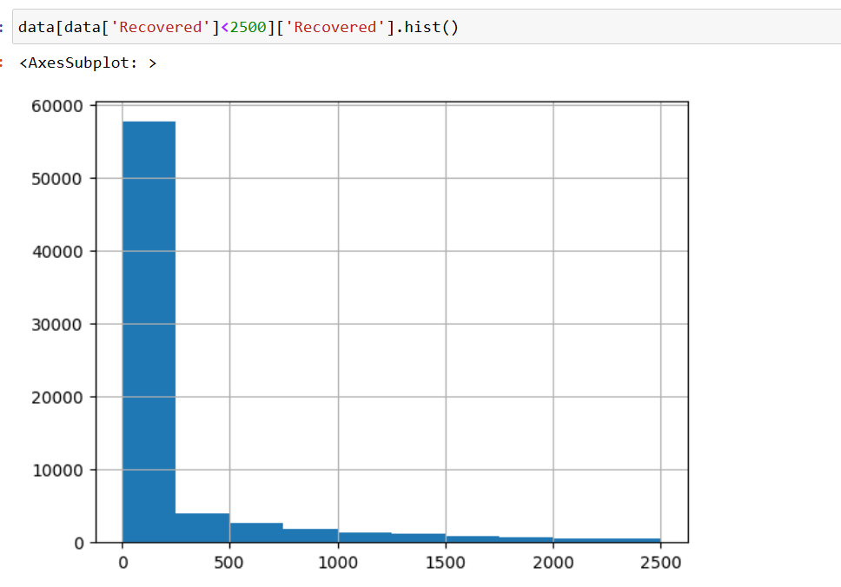
CORONAVIRUS DISTRIBUTION
After eliminating the outliers, I could display a valid histogram for the spread of corona cases recorded.
Deaths
Recovered
Confirmed

Slide 9
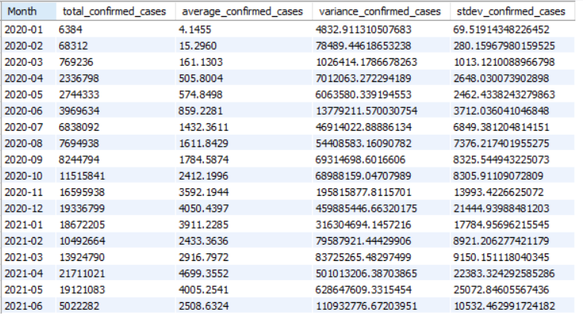
CONFIRMED MONTHLY SPREAD
Monthly confirmed cases spread
2020
2021

Slide 10

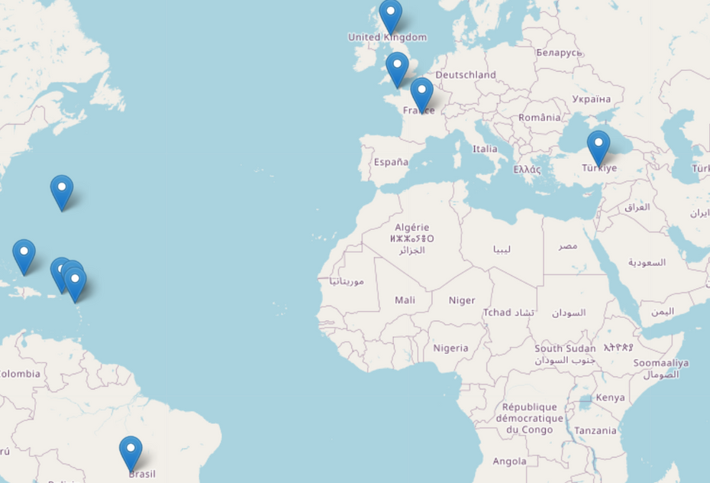
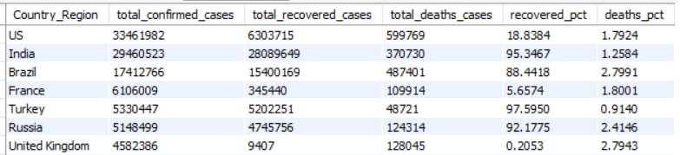
COUNTRIES WITH HIGHEST CONFIRMED CASES
US, India and Brazil scored the highest countries with confirmed cases according to our data

Slide 11
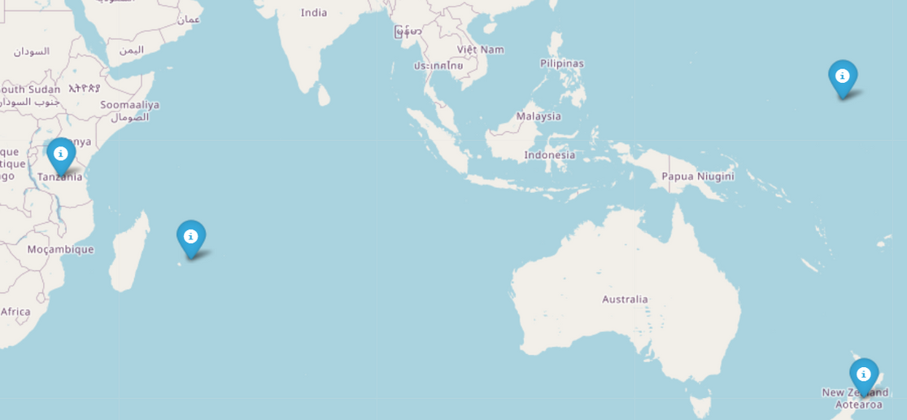
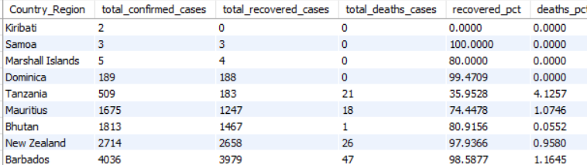
COUNTRIES WITH LOWEST CONFIRMED CASES
Kiribati, Samoa, Dominica and New Zealand scored the lowest with confirmed cases

Slide 12
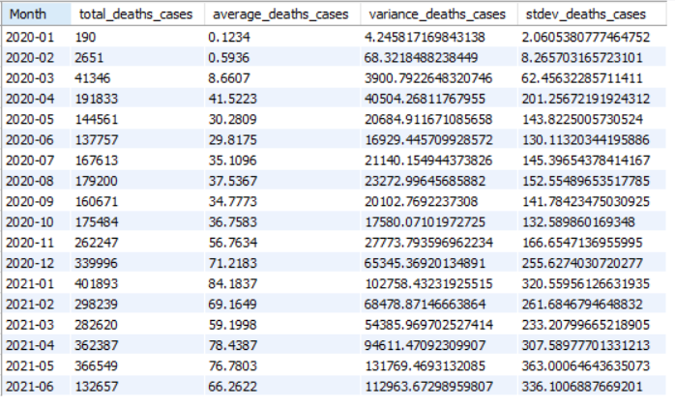
DEATHS MONTHLY SPREAD
Monthly death cases spread
2020
2021

Slide 13
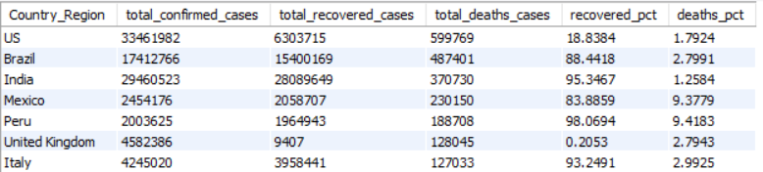
COUNTRIES WITH HIGHEST DEATH CASES
US, India and Brazil scored the highest countries with death cases according to our data

Slide 14
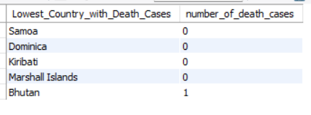
COUNTRIES WITH LOWEST DEATH CASES
Samoa, Dominica, and Kiribati scored ZERO death cases according to our data

Slide 15
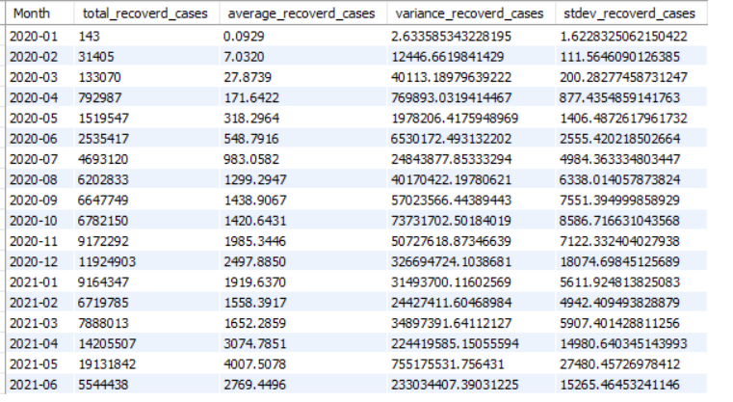
RECOVERED MONTHLY SPREAD
Monthly recovered cases spread
2020
2021

Slide 16
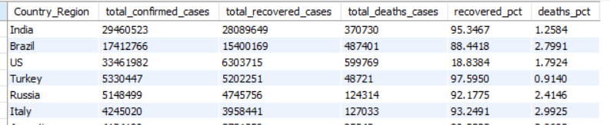
COUNTRIES WITH HIGHEST RECOVERED CASES
India and Brazil, then comes US are the countries that scored the highest countries with recovered cases according to our data

Slide 17
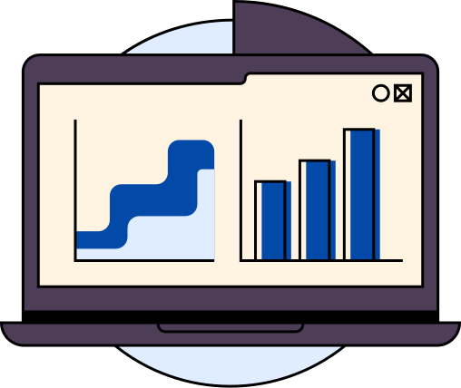
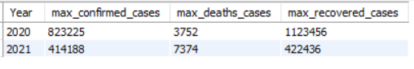
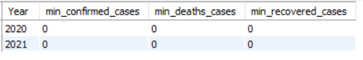
YEARLY ANALYSIS [2020 VS. 2021]
Assuming Granularity in our collected data, Max confirmed cases were captured in 2020, Having more than 80 thousands of corona cases.
But, interestingly, The deaths cases were at their maximum in 2021.
In both years, we were lucky to record zero corona cases!

Slide 18

CONCLUSION
The analysis of the coronavirus dataset has provided valuable insights into the spread and impact of the virus.
Key Findings:
The total number of confirmed cases, deaths, and recoveries each month.
The average, variance, and standard deviation of confirmed cases, providing an understanding of the spread pattern.
The most affected countries in terms of confirmed cases, deaths, and recoveries.
The monthly trend of the virus spread, highlighting the areas of concern and improvement.
These insights helped in better understanding the dynamics of the pandemic and can help in formulating effective strategies for its containment and mitigation.

Slide 19


